Slide 1


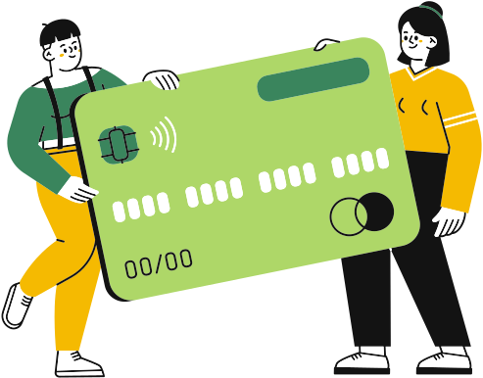


Project Guide : Dr. Kavita Jain
Product Recommendation System For Credit Card Holders
Prashant Srivastava A068
Harsh Tantak A069
Sandesh Tayde A070
Ashwajit Ubale A071
Dev Vatnani A072

Slide 2




Overview
Introduction
Objectives
Data Description
Methodology
Result
Conslusion
Limitaions
Future scope

Slide 3


Introduction
This project aims to build a comprehensive, data-driven credit card product recommendation system tailored to individual users. It integrates three major components—Fraud Detection, Customer Segmentation, and Product Recommendation—to create a secure, personalized, and efficient pipeline. By leveraging machine learning and deep learning techniques, the system analyzes transactional behavior, identifies potential fraud, clusters users based on financial profiles, and recommends suitable credit card products, enhancing user experience and business value.

Slide 4
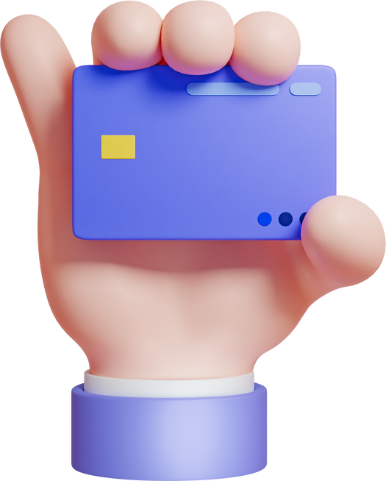
Aims & Objectives
Fraud Detection
Customer Segmentation
Recommendation System
Develop a model to identify suspicious credit card transactions that may indicate fraud and implement real-time data monitoring to flag potentially compromised accounts.
Analyze users' transaction behaviors to identify patterns based on card usage and history.
Create a recommendation system that offers tailored financial services or products based on
different user.

Slide 5

Data Description
The dataset presents an extensive collection of around 2.71 crore credit card transactions, sourced from IBM's financial database. The data covers 2000 consumers resident in the United States, but who travel the world. The data also covers decades of purchases, and includes multiple cards from many of the consumers.
Dataset:
sd254_cards.csv (Credit Card Information)
sd254_users.csv (User Demographics and Financial Info)
User_credit_card_transactions.csv (Transaction Logs)

Slide 6

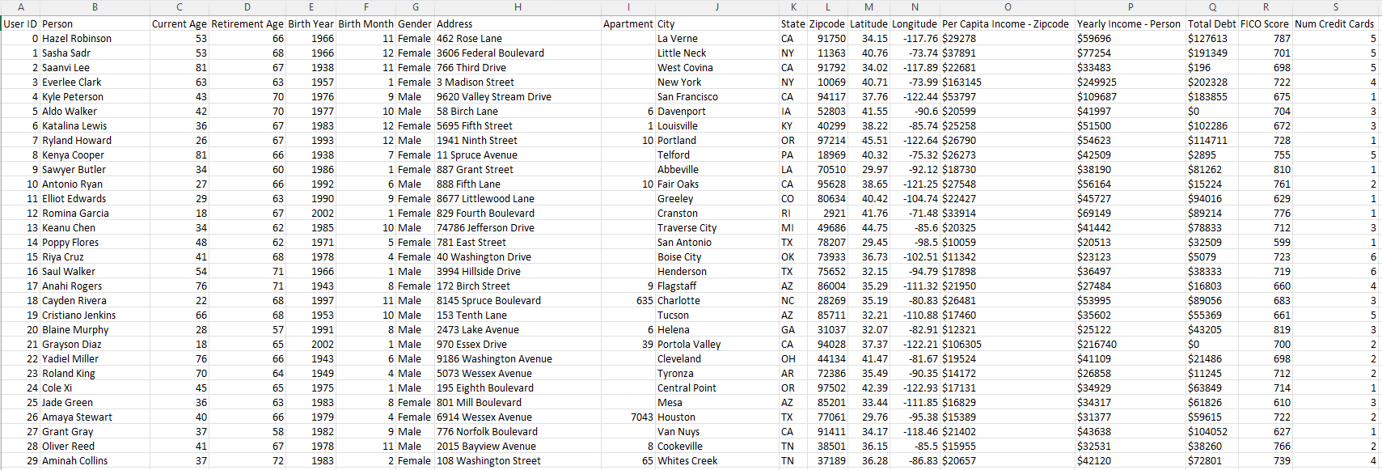
User Demographics and Financial Information

Slide 7

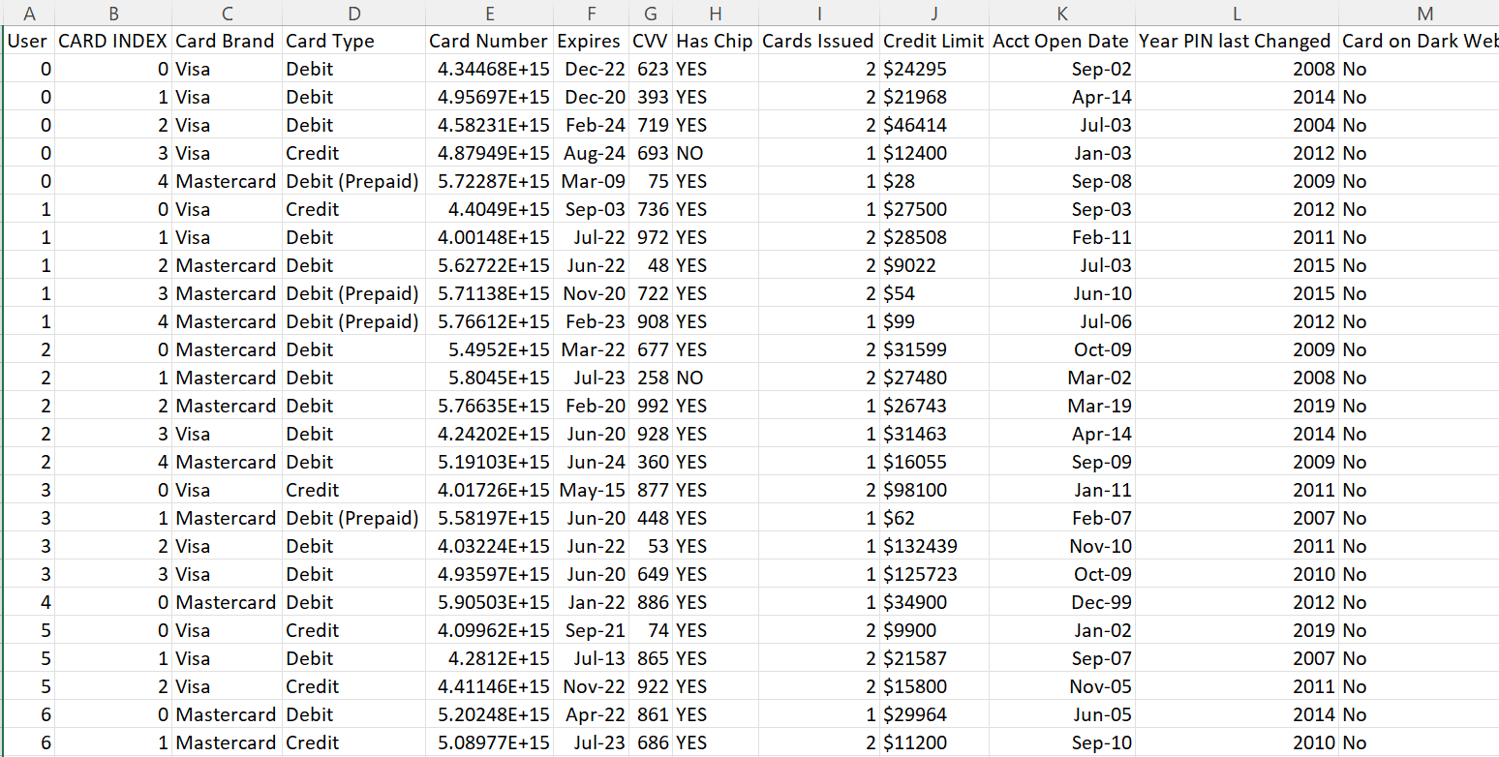
Credit Card Information

Slide 8

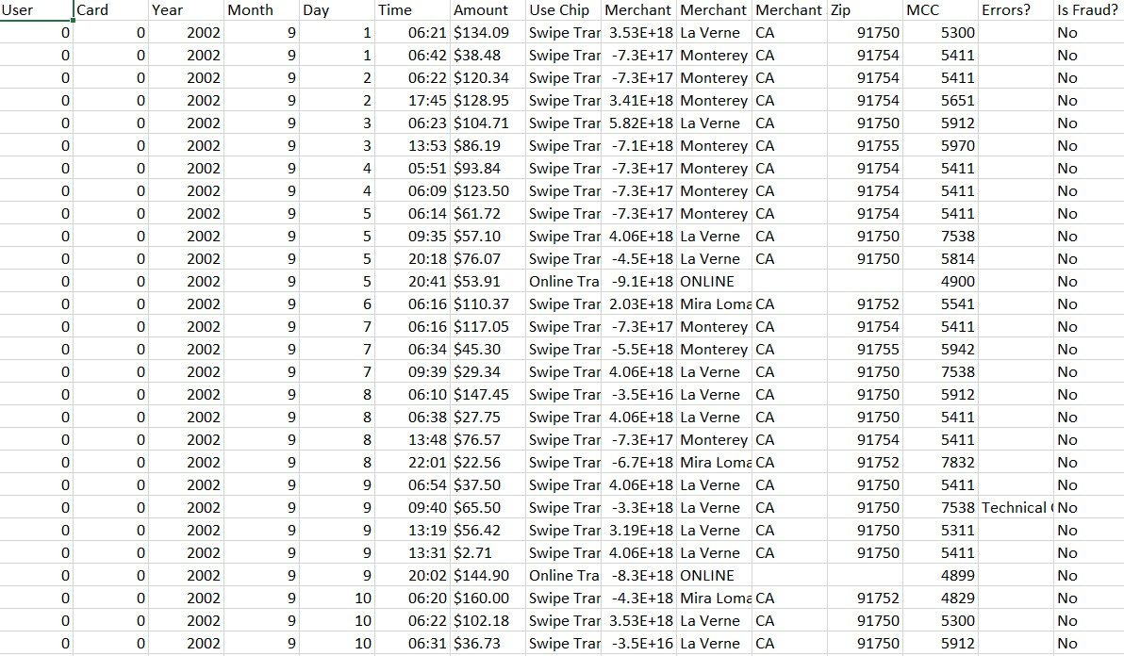
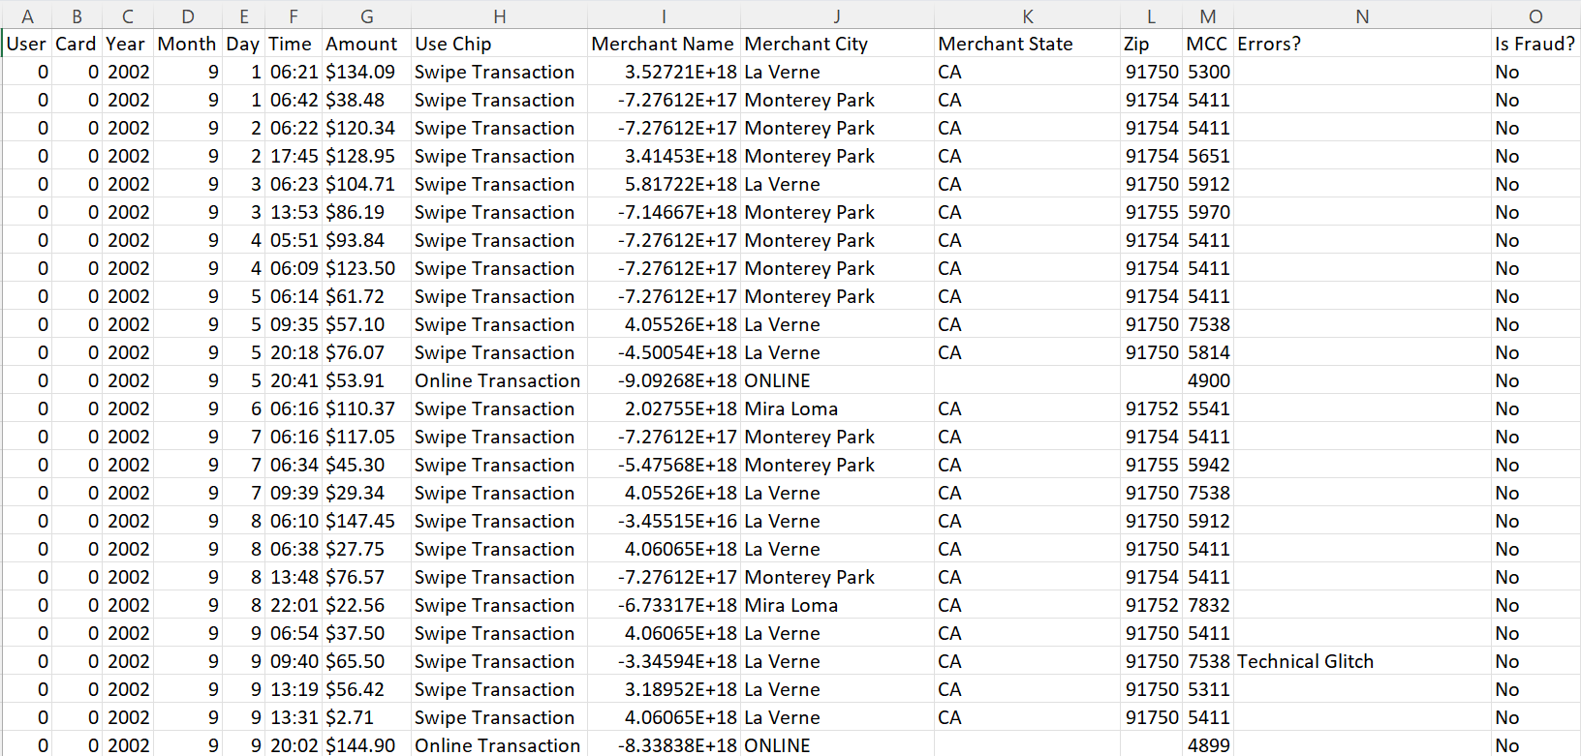
Credit Card Information
Transaction Dataset
Transaction Logs

Slide 9

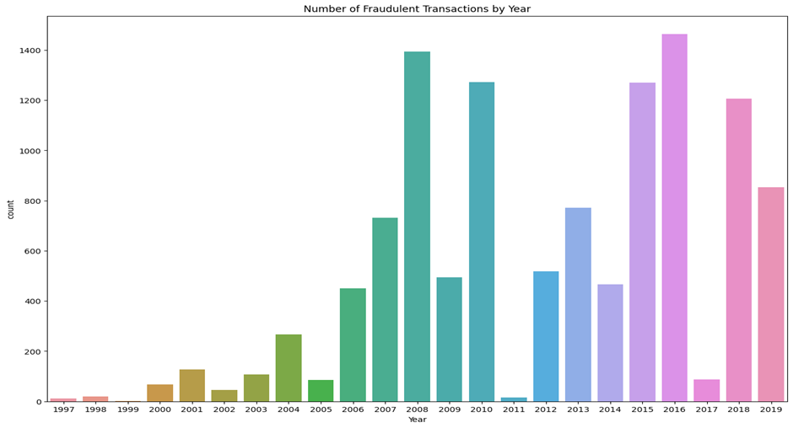
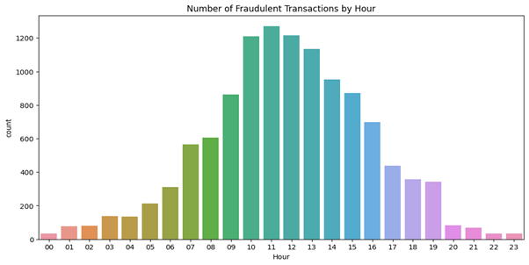
Exploratory Data Analysis
Number of Fraudulent Transactions by Hour
Number of Fraudulent Transactions by Year

Slide 10

FRAUD DETECTION
01.
CUSTOMER SEGMENTATION
02.
Methodology
RECOMMENDATION MODEL
03.

Slide 11

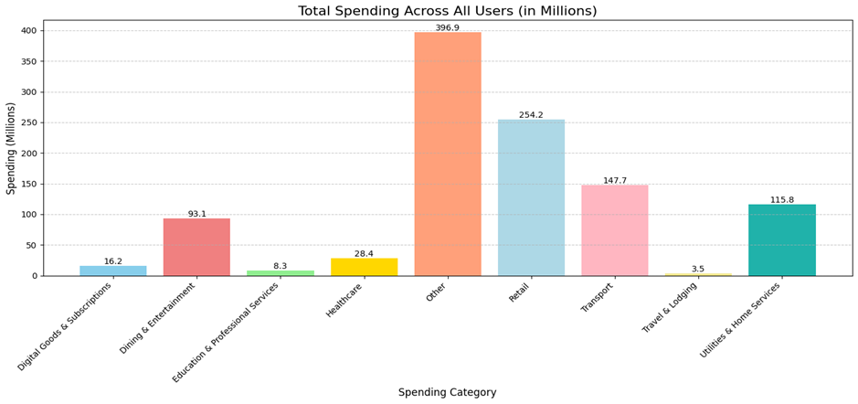
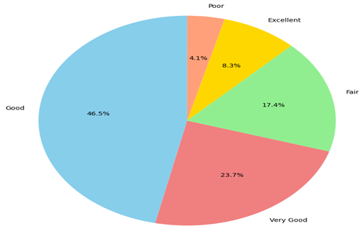
Exploratory Data Analysis
Fraud Detection
Distribution of FICO Categories
Total Spending Across All Users on Different Category

Slide 12

REMOVING FRAUDLENT TRANSACTIONS
Financial fraud detection is an important problem in the field of electronic transactions.
Analyzed 2.7M+ credit card transactions across 2,000 users.
Each transaction is labeled as fraudulent (1) or genuine (0).
Addressed extreme class imbalance – frauds form a small fraction of the data.
Developed fraud detection models using Random Forest and XGBoost.
Features include user behavior, transaction characteristics, and merchant data.
Focused on maximizing fraud detection while minimizing false positives.

Slide 13
Final Results
Interpretation-
1. Random Forest Shows Overfitting Tendencies:
oRandom Forest achieves perfect accuracy (100%) on the test set, but this is misleading due to its high train accuracy (100%), indicating potential overfitting.
2. XGBoost Provides Better Generalization:
oXGBoost, while slightly lower in overall accuracy (Train: 94%, Test: 96%), demonstrates a healthier balance between train and test performance.
Metric | Random Forest | XG-Boost
Accuracy | 93% | 94%
Precision | 0.91 | 0.92
Recall | 0.81 | 0.85
F1-Score | 0.85 | 0.88
False Negatives | 955 | 734
False Positives | 230 | 264
Overfitting Tendency | High ( Accuracy=100%) | Moderate ( Accuracy=96%)

Slide 14
GRAPH NEURAL NETWORK (GNN) FOR FRAUD DETECTION
We employed a Graph Neural Network (GNN)-based approach to enhance the detection of fraudulent credit card transactions by leveraging the relational structure between entities involved in the payment ecosystem. Traditional machine learning models often treat transactions independently, missing out on latent patterns across interconnected users and merchants. To overcome this, we constructed a bipartite graph where each node represented either a card or a merchant, and each edge represented a transaction enriched with features such as transaction amount, time, chip usage, merchant category code (MCC), and error codes.

Slide 15
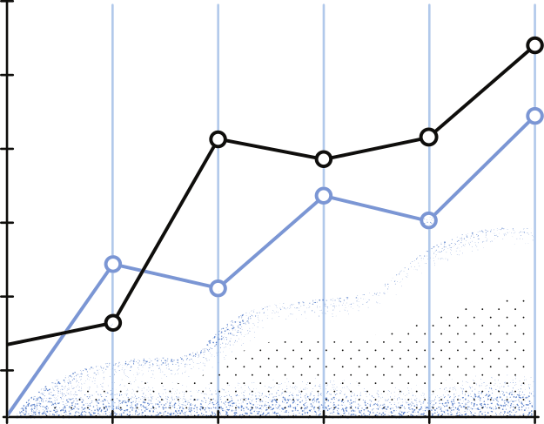
GRAPH STRUCTURE
Graph Construction
We constructed a heterogeneous transaction graph G = (V, E) using NetworkX:
Nodes: Each node represents a card_id or merchant_name.
Edges: Each edge represents a transaction between a card and a merchant. Edge attributes include:
Time (Year, Month, Day, Hour, Minute)
Transaction Amount
Binary feature Use Chip
Categorical Merchant City, MCC, and Errors?
Feature Preparation
We extracted the edge attributes into a feature matrix X ∈ ℝ^{n×d}:
Each row represents a transaction (edge)
Each column corresponds to a numerical feature
Categorical variables were either encoded or omitted in early versions for memory efficiency

Slide 16
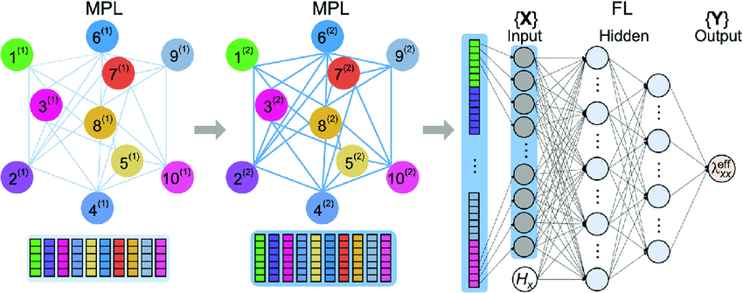
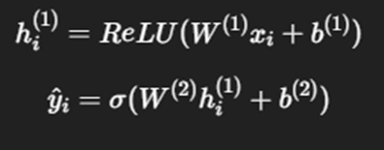
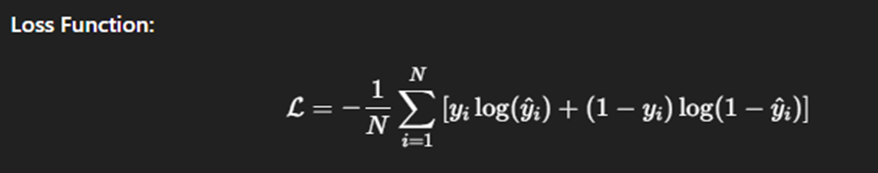
GNN ARCHITECTURE
ACTIVATION FUNCTION
LOSS FUNCTION

Slide 17
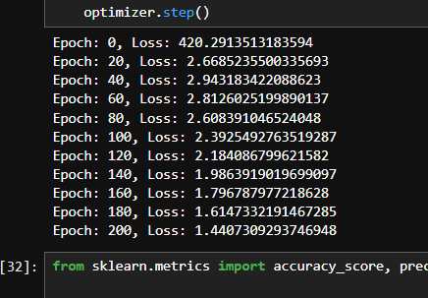
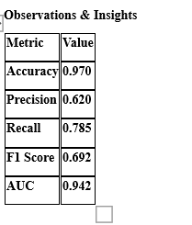
GNN RESULTS
LOSS REDUCTION CONFIRMED TRAINING SUCCESS.
DESPITE HIGH ACCURACY, METRICS LIKE PRECISION AND RECALL REMAINED LOW DUE TO CLASS IMBALANCE.
LOSS VALIDATION

Slide 18
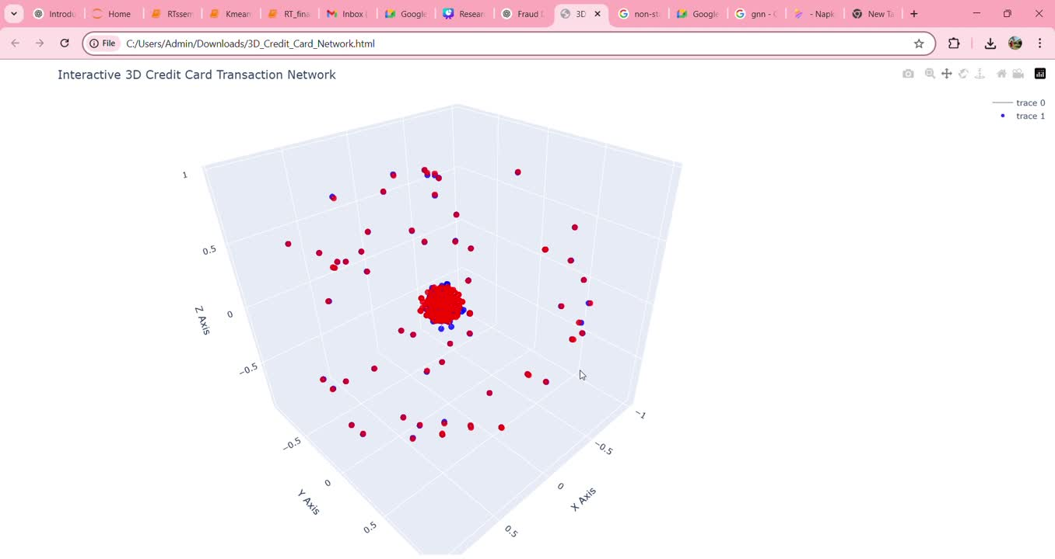
GNN VISULIZATION

Slide 19
Exploratory Data Analysis
Customer Segmentation
Distribution of FICO Categories
Total Spending Across All Users on Different Category

Slide 20

CUSTOMER SEGMENTATION
This stage aims to group users with similar behavior and financial patterns using only non-fraudulent transactions. We created a detailed dataset by combining transaction, user, and card information to support personalized services and better fraud risk analysis.
The dataset includes 2,000 users with 25 features covering demographics, financial standing, credit risk, transaction behavior, and activity metrics. This data is aggregated and filtered to exclude users with any fraudulent transactions, focusing solely on genuine user behavior.

Slide 21
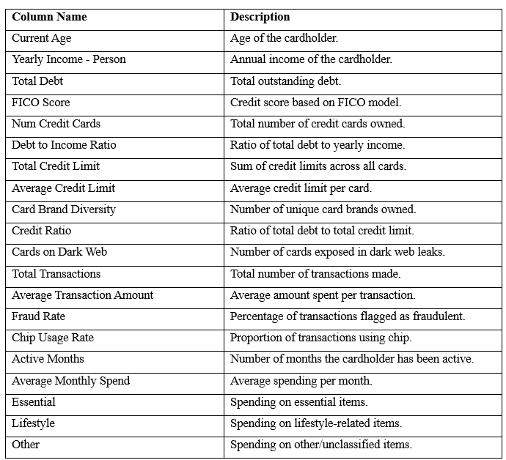
Preprocessing Pipeline
1. Outlier Detection and Removal
Outliers were identified using the IQR method across all numeric features. Observations falling outside 1.5×IQR from the quartiles were removed to avoid distortion in cluster boundaries.
2. Feature Scaling
All numerical features were standardized using StandardScaler to normalize feature distributions, ensuring uniform influence on distance-based algorithms like K-Means.
3. Dimensionality Reduction
To support cluster visualization and reduce noise, Principal Component Analysis (PCA) was used to reduce the feature space to 2 dimensions. This also aids in detecting natural groupings visually.
4. Multicollinearity Check (VIF)
Variance Inflation Factor (VIF) was calculated for each feature to detect multicollinearity. Features with high VIF were flagged as potentially redundant and monitored to improve cluster quality and interpretability.

Slide 22
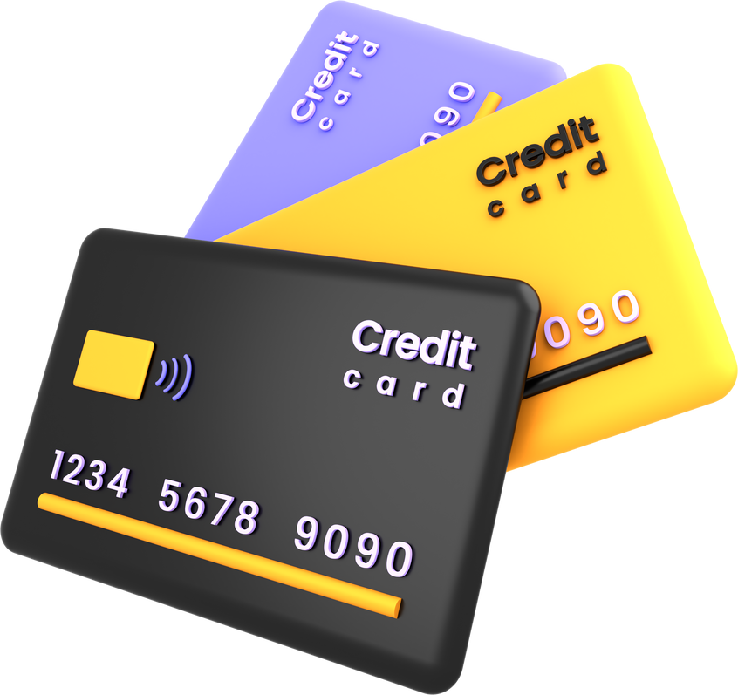
K - Means Clustering
We first applied the K-Means clustering algorithm, a widely used unsupervised learning technique that partitions data into a predefined number of clusters (K).
The algorithm follows these steps:
Initialization: Select K initial centroids (either randomly or using smarter methods like K-Means++).
Assignment Step: Assign each point to the nearest centroid, forming clusters.
Update Step: Recalculate the centroids as the mean of the points in each cluster.
Repeat the assignment and update steps until convergence (when centroids no longer move significantly).
To visualize high-dimensional data in 2D, we used Principal Component Analysis (PCA) for dimensionality reduction.

Slide 23
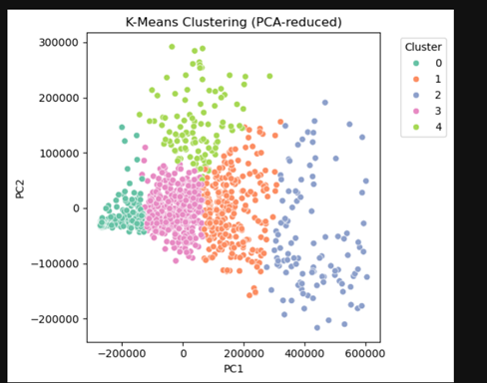
K-Means Evaluation Scores:
Silhouette Score: 0.6092
Davies–Bouldin Score: 0.9941
A higher Silhouette score and a lower Davies–Bouldin score indicate better-defined clusters.

Slide 24
Model Comparison
We compared K-Means against other popular clustering algorithms, including K-Means++, Gaussian Mixture Models (GMM), DBSCAN, and K-Prototypes. Each model was tested on the same PCA-reduced dataset to ensure consistency.
Algorithim | SIlhouettte Score | Db Score
K-Mean | 0.6092 | 0.9941
K-Means++ | 0.355 | 1.05
Gaussian Mixture | 0.330 | 1.21
DbScan | 0.295 | 1.30
K-prototypes | 0.310 | 1.15
As evident, K-Means outperformed all other models in terms of both metrics, making it the most suitable clustering method for our dataset.

Slide 25

Young, Low-Commitment Users
Mature, Budget-Conscious
Young, low-income users new to credit; low spend and credit use.
Mature, conservative users; low spend, focused on financial safety.
Clusters
Middle-Aged, Balanced Users
High-Spending Power Users
Affluent Lifestyle Users
Middle-aged, balanced users; moderate spend and responsible credit behavior.
Older, affluent users; high spenders with excellent credit
Affluent lifestyle users; digitally engaged with high lifestyle spend.

Slide 26
Exploratory Data Analysis
Recommendation System
Distribution of FICO Categories
Total Spending Across All Users on Different Category

Slide 27
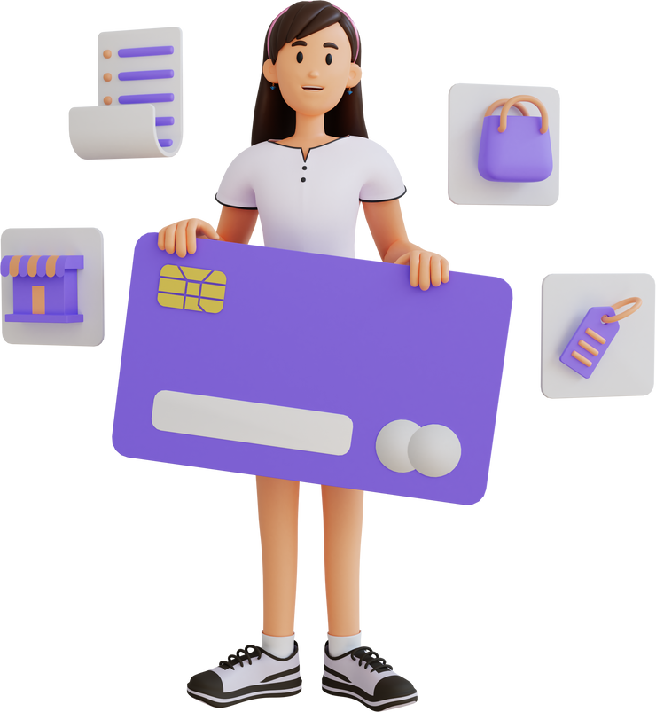
Collaborative Filtering
Recommends products based on user-user or item-item similarities.
Learns from historical interactions (e.g., transactions, ratings) across users.
Assumes similar users prefer similar products.
Applied here to suggest credit cards based on behavior of users with similar profiles.

Slide 28
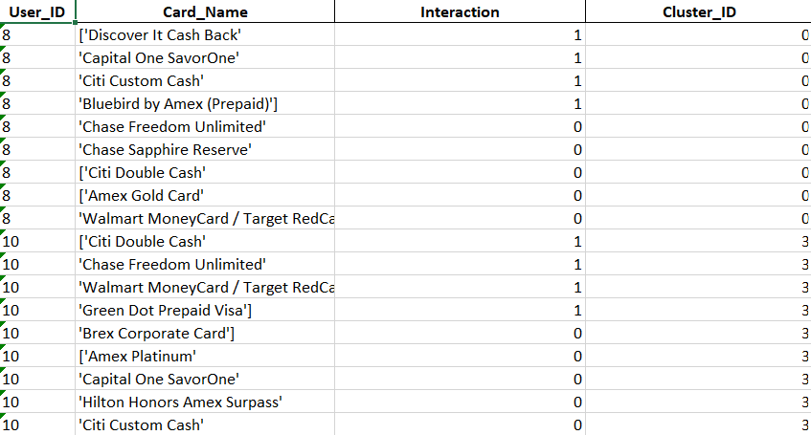
Interaction Dataset
Created a user-card interaction dataset by mapping transactional behavior with card attributes to capture meaningful user preferences.

Slide 29
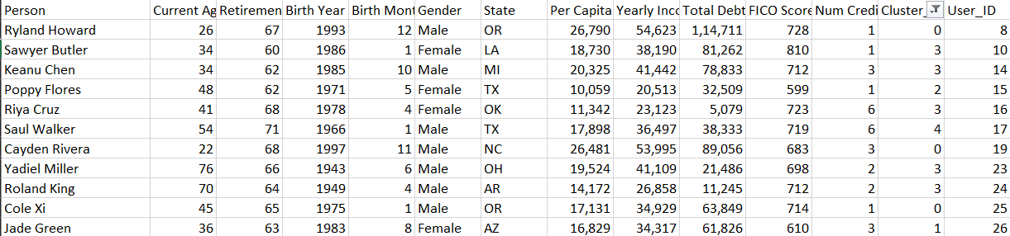
User Cluster Dataset And Card Cluster Dataset
Card Type Cluster
User Cluster

Slide 30
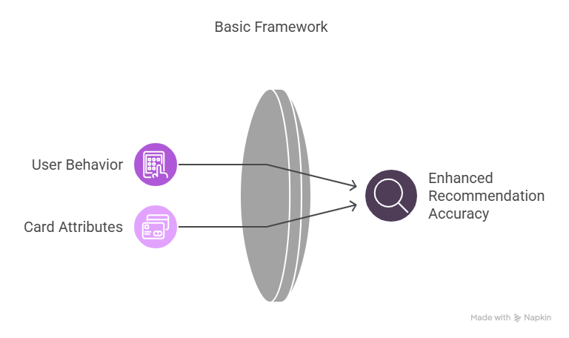
Neural Collaborative Filtering
Neural Collaborative Filtering (NCF) uses deep learning to model complex, non-linear interactions between users and products. Unlike traditional collaborative filtering, NCF learns user and item embeddings through neural networks, capturing higher-order feature interactions. In this project, NCF was employed to improve recommendation accuracy by leveraging both user behavior and card attributes.

Slide 31
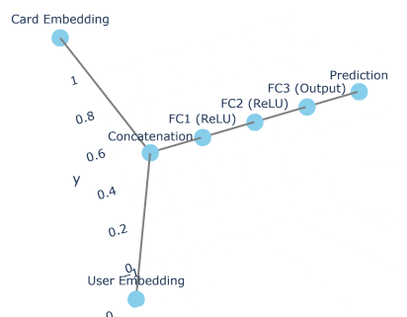
Model Architecture
User Embedding: Embedding(1220, 16)
Item Embedding: Embedding(21, 16)
Fully Connected Layers:
fc1: Linear(32 → 128)
fc2: Linear(128 → 64)
fc3: Linear(64 → 32)
out: Linear(32 → 1)
Activation & Regularization:
Dropout: p = 0.3

Slide 32
Evaluation Metrics
Metric | Value | Interpretation
Accuracy | 0.9495 | Overall correct predictions
Precison | 0.9255 | Correct positive predictions
Recall | 0.9668 | Capturing actual positives

Slide 33
Recommendation Metrics
Precision@K: Measures the proportion of recommended items in the top-K list that are relevant.
Recall@K: Measures the proportion of relevant items that appear in the top-K recommendations.
NDCG@K (Normalized Discounted Cumulative Gain): Considers the position of the relevant items in the recommended list — higher-ranked relevant items get more weight.
Hit Rate@K: Checks whether at least one relevant item is present in the top-K recommendations.
MAP@K (Mean Average Precision): Averages the precision across multiple users at different K values for better overall insight.

Slide 34
Recommendation Metrics
Metric | Value | Interpretation
Hit@10 | 0.9639 | % of users with at least 1 relevant item in top 10
Precison@10 | 0.2110 | Relevant items in top 10 recommendations
Recall@10 | 0.5084 | Coverage of relevant items in top 10
MRR@10 | 0.4056 | Rank position of the first relevant item
NDCG@10 | 0.3567 | Position-aware ranking quality of recommendations

Slide 35
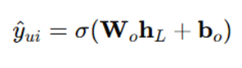
Prediction Score
The prediction score represents the likelihood of a user interacting with a specific credit card product.
Output from the Neural Collaborative Filtering (NCF) model ranges from 0 to 1, where higher scores indicate stronger user-product affinity.
Used to rank and recommend the most relevant cards to each user.

Slide 36
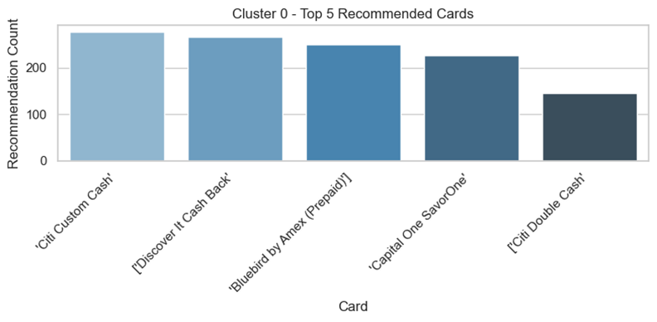
Top Recomnded Cards Per Cluster
‘Citi Custom Cash’ is the most recommended card, meaning it fits well with the spending habits of this user group.
Other popular cards include ‘Discover It Cash Back’, ‘Bluebird by Amex (Prepaid)’, and ‘Capital One SavorOne’ — all reward or cash-back focused.
‘Citi Double Cash’ was recommended the least among the top 5, but still relevant to many users.
These results help us understand what types of cards users in this cluster prefer.

Slide 37
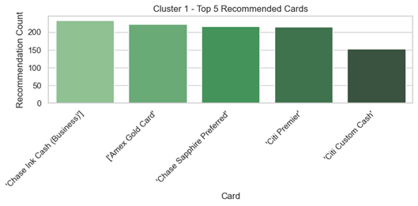
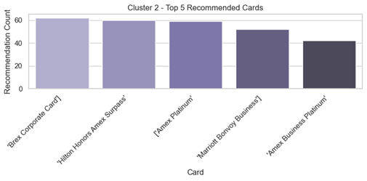
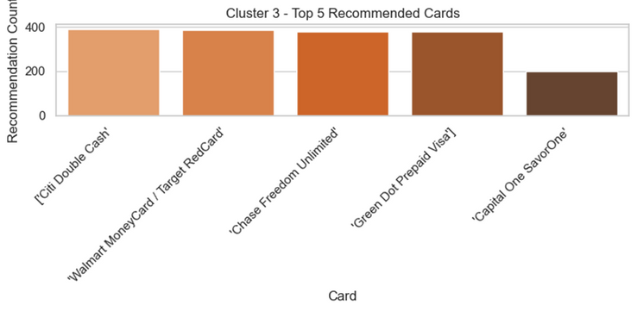
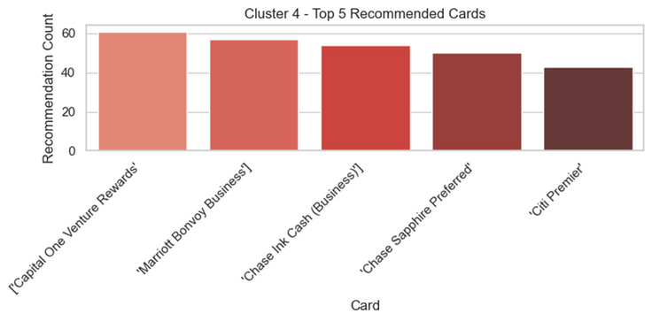
Top Recomnded Cards Per Cluster

Slide 38
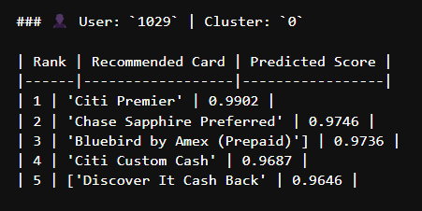
Recommended Cards Per User

Slide 39


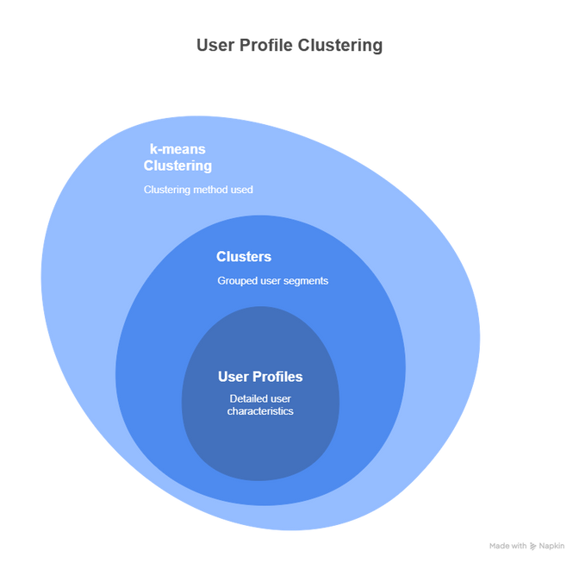
Conclusions
k-means Clustering: This is the method which has given us best silhouette score (0.6092)
We have 5 clusters which further interpretation is made on user profiles (FICO score, user income, age )

Slide 40
Conclusions
We used a neural network to predict which credit card a user might like.
The model learns patterns by converting users and cards into number-based representations called embeddings.
These embeddings are combined and passed through multiple layers to understand complex user-card relationships.
The final layer gives a score (between 0 and 1) showing how likely a user is to prefer a card.
Cards with high scores are then recommended to the user.

Slide 41

Limitations
1. Static Clustering Problems :
User behavior evolves over time, and static clustering models do not adjust. The selection of the number of clusters is a subjective decision that affects the quality of recommendations.
2. Generalization of Recommendations :
Recommendations derived from user clusters may not suit each user in the cluster. Users can have personalized tastes that broad recommendations will fail to capture.
3. Computational Complexity :
Processing large datasets can be computationally intensive, particularly for sophisticated algorithms that might need sophisticated hardware.
4. Cold Start Problem :
New users with sparse transaction history might not be classified correctly or might get bad recommendations until sufficient data is present.

Slide 42


Personalized Recommendations :
Cross-Platform Integration :
Future systems will harness deep learning for tailored, context-aware suggestions based on user behavior and trends.
The model can extend to mobile, e-commerce, and POSsystems, integrating various financial tools for a seamless user experience.
Future Scope
Scalability :
Domain Adaptation :
Scalable cloud infrastructure will ensure consistent performance and support real-time analytics as user numbers grow..
This approach can also apply to mobile payments, fraud detection, investment analysis, and customer segmentation in various industries.

Slide 43
Thank you !

